Slide 1

Go, change the world
RV College of
Engineering
Design of Blood Donation Website
18EC74 : BE Internship Phase I Presentation
ANAND 1RV20EC021
Guide Name: Dr. Jayanthi P.N.
Designation: Professor
Department of Electronics and Communication Engineering
*
Department of ECE
1

Slide 2

Go, change the world
RV College of
Engineering
Outline
Internship offer letter / Certificate of completion of internship (with name and duration of internship)
Profile of the organization
Activities of the organization
Tasks performed (in detail)
Outcome of internship
*
Department of ECE
2

Slide 3

Go, change the world
RV College of
Engineering
Internship offer letter
Internship offer given by Das CNC Product Pvt Ltd.
It was from September 25th to November 13th for a duration of 7 weeks.
*
Department of ECE
3

Slide 4
Go, change the world
RV College of
Engineering
Profile of the organization
Founded in 1985 as a proprietary concern to process Turned Components on job work basis mainly on Automatic Lathes.
With a high determination on quality and ability to develop new products in very short time the company has been witnessing continuous growth. In year 2009 it was converted to a private limited company.
*
Department of ECE
4

Slide 5
Go, change the world
RV College of
Engineering
Activities of the organization
Manufacturing Auto Turned Components & assemblies.
Manufacturing components which require high precision engineering. Development of components
Some of the products includes:
Adapters
Glow Plug Hosing
CNC turning center
Nut knurled Caps
*
Department of ECE
5

Slide 6
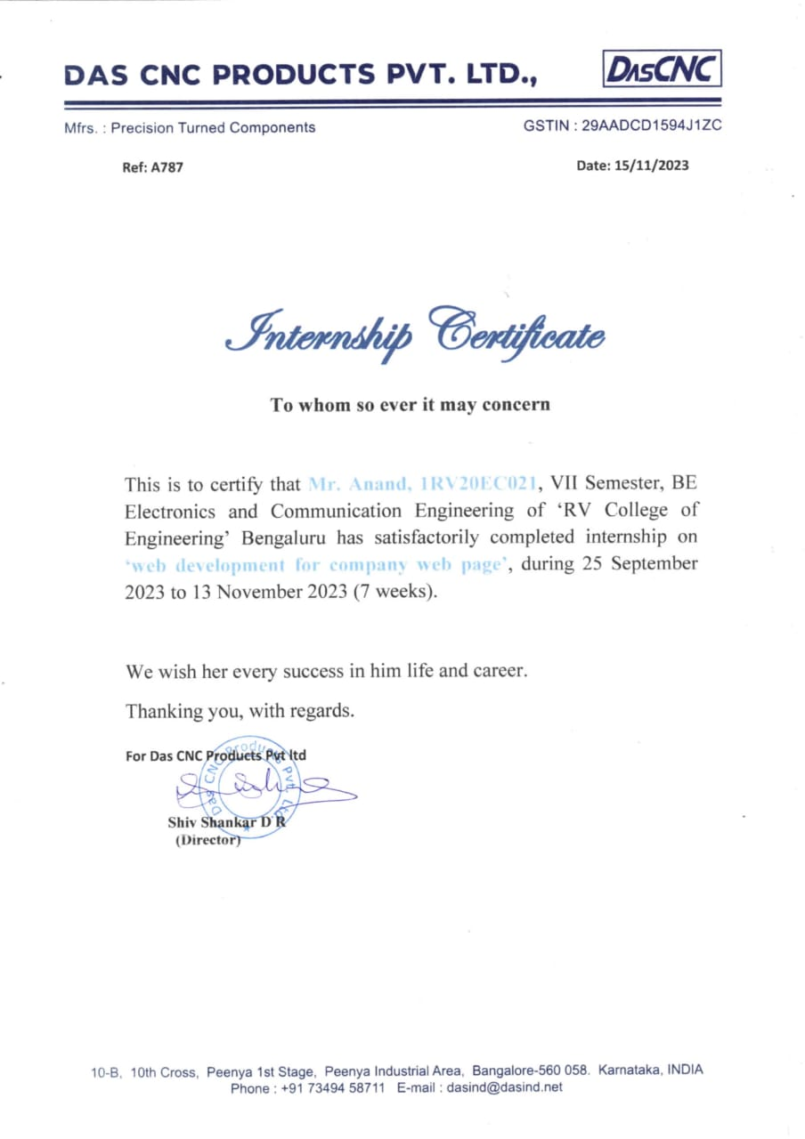
Go, change the world
RV College of
Engineering
Internship Certificate
*
Department of ECE
6

Slide 7
Go, change the world
RV College of
Engineering
Problem statement
Blood donation is a noble act that saves countless lives every day. So to have a website where a person in need of blood can connect to the blood donor.
*
Department of ECE
7

Slide 8
Go, change the world
RV College of
Engineering
Objectives
Have a test customer database with address and/or geo tags.
Add address or geo tags where ever required. Generate geo tags from the address.
Collect the information about blood group, blood donor interest, date of donate etc.
Display/plot if any blood donors surrounding who is eligible for donate.
*
Department of ECE
8

Slide 9
Go, change the world
RV College of
Engineering
Tasks performed during internship
Front-End Development:
User Registration:
Implemented responsive design using HTML, CSS, and Bootstrap.
Ensured a seamless and user-friendly interface for both donors and recipients.
Designed and implemented a donor registration form using HTML and PHP.
Validated and stored donor information securely in the database.
*
Department of ECE
9

Slide 10
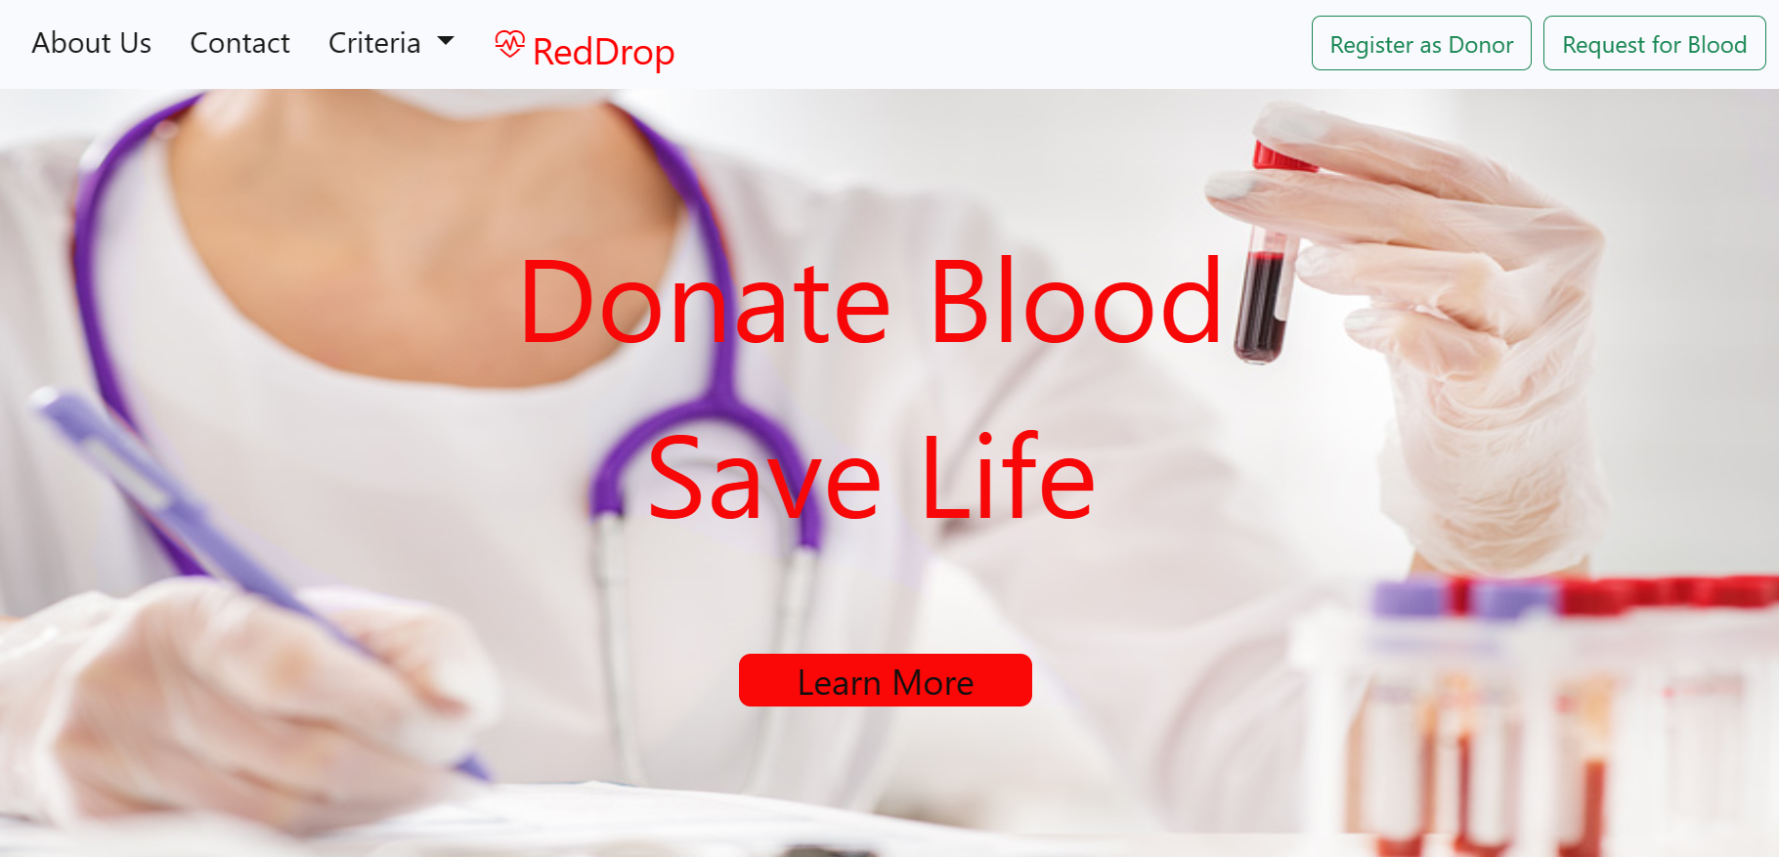
Go, change the world
RV College of
Engineering
Tasks performed during internship
*
Department of ECE
10

Slide 11
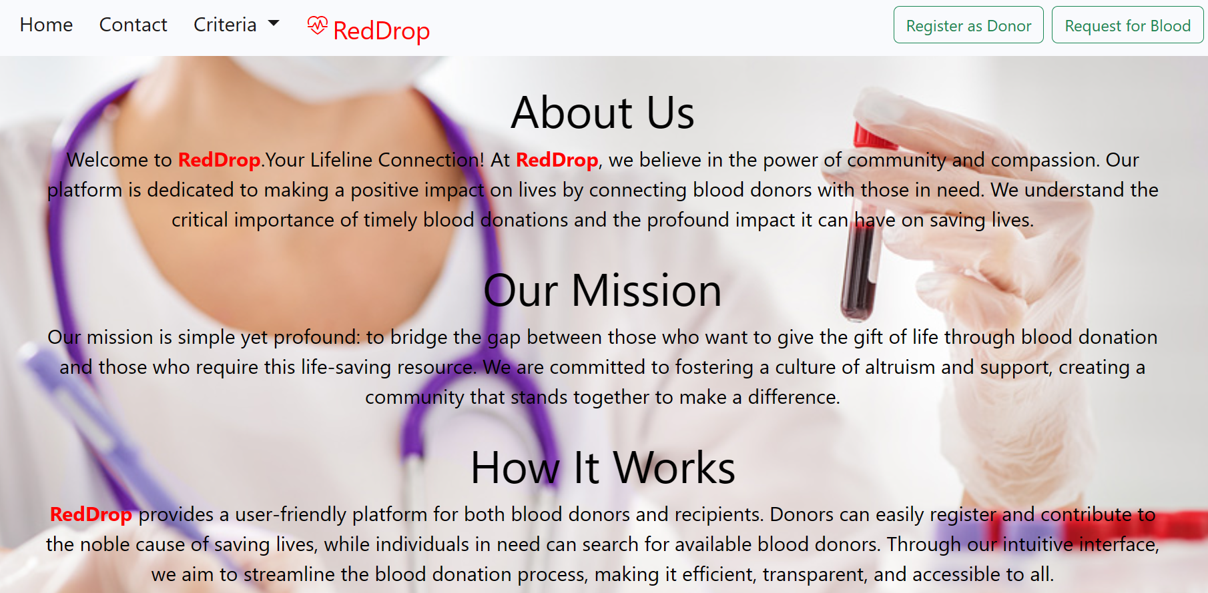
Go, change the world
RV College of
Engineering
Tasks performed during internship
*
Department of ECE
11

Slide 12
Go, change the world
RV College of
Engineering
Tasks performed during internship
Search Functionality:
Google Maps Integration:
Developed a robust search form using HTML, PHP, and JavaScript.
Enabled users to search for donors based on various criteria, such as location and blood type.
Integrated Google Maps API for dynamic location services.
Displayed the contact details and donor locations on the map for better user engagement.
*
Department of ECE
12

Slide 13
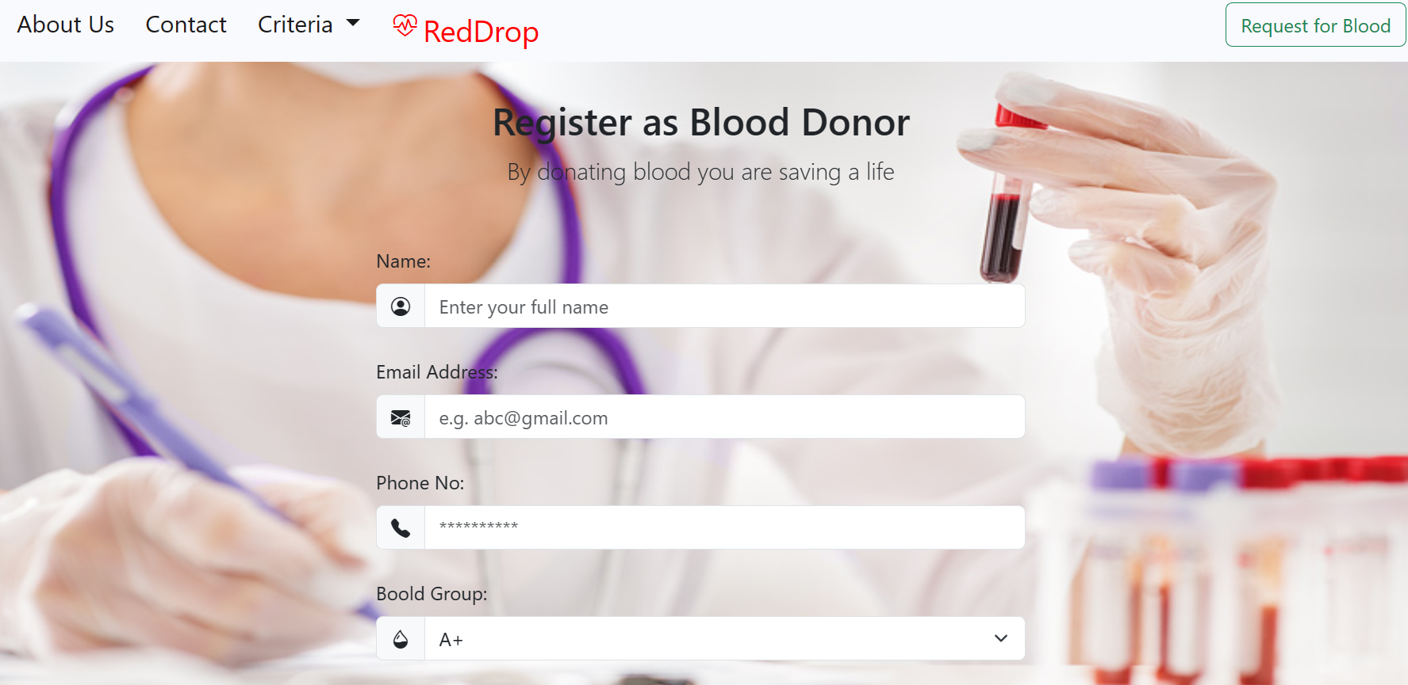
Go, change the world
RV College of
Engineering
Tasks performed during internship
*
Department of ECE
13

Slide 14
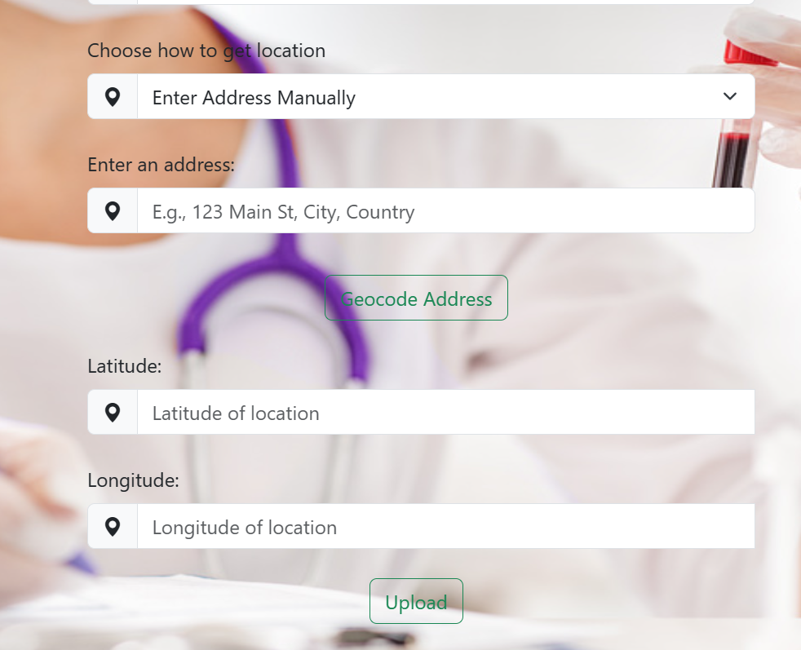
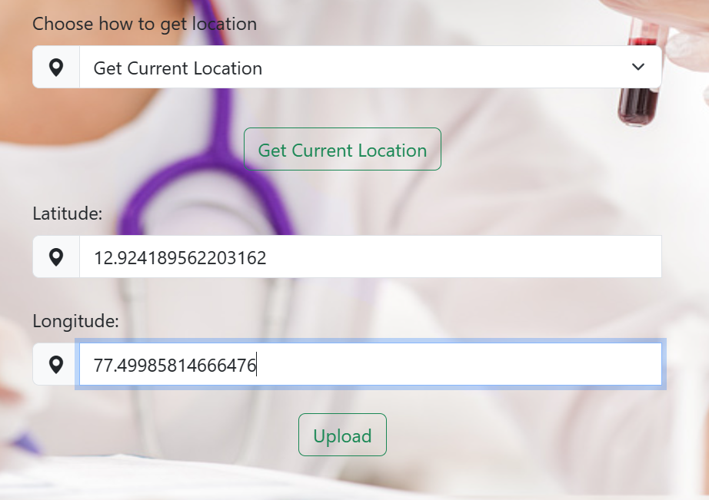
Go, change the world
RV College of
Engineering
Tasks performed during internship
*
Department of ECE
14

Slide 15
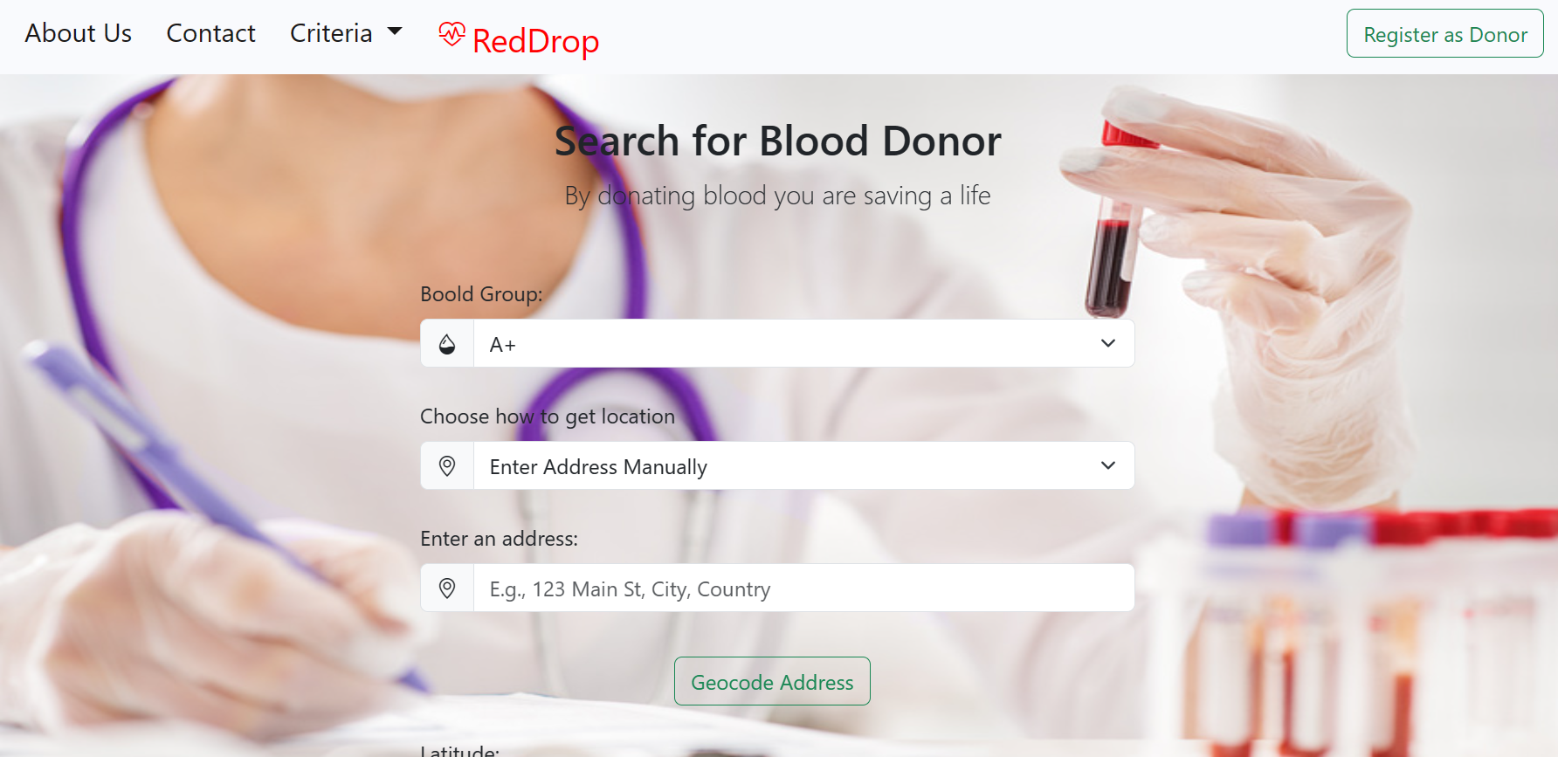
Go, change the world
RV College of
Engineering
Tasks performed during internship
*
Department of ECE
15

Slide 16
Go, change the world
RV College of
Engineering
Tasks performed during internship
Database Management:
Forward and Backward geocoding:
Established and managed a secure database for storing donor and recipient information.
Implemented database queries for efficient data retrieval and storage.
Converting the entered address into geotags i.e. latitude and longitude.
User can also give location as his/her current location which is also converted to geotags.
*
Department of ECE
16

Slide 17
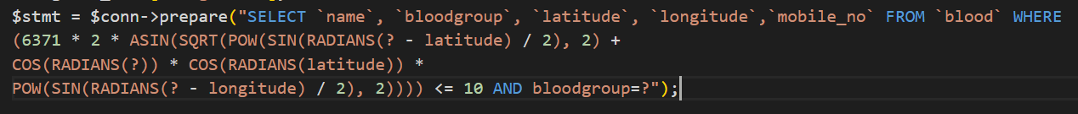
Go, change the world
RV College of
Engineering
Tasks performed during internship
*
Department of ECE
17

Slide 18
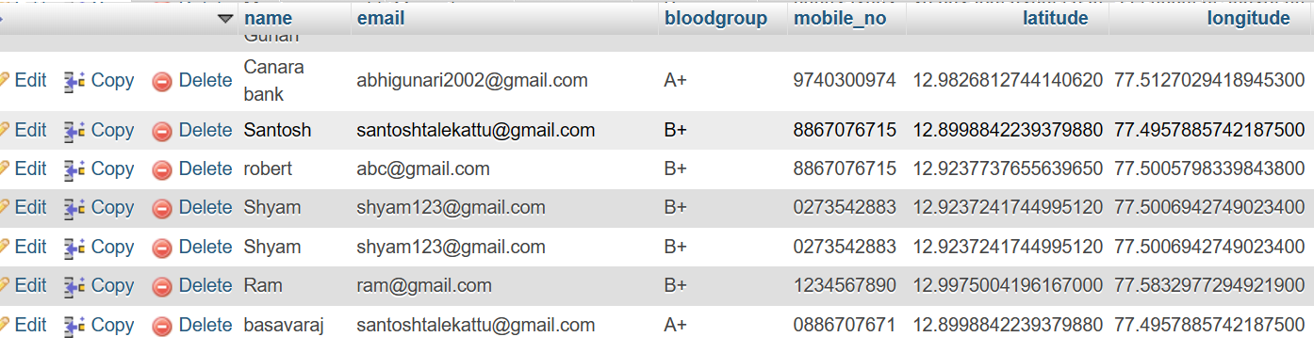
Go, change the world
RV College of
Engineering
Tasks performed during internship
*
Department of ECE
18

Slide 19
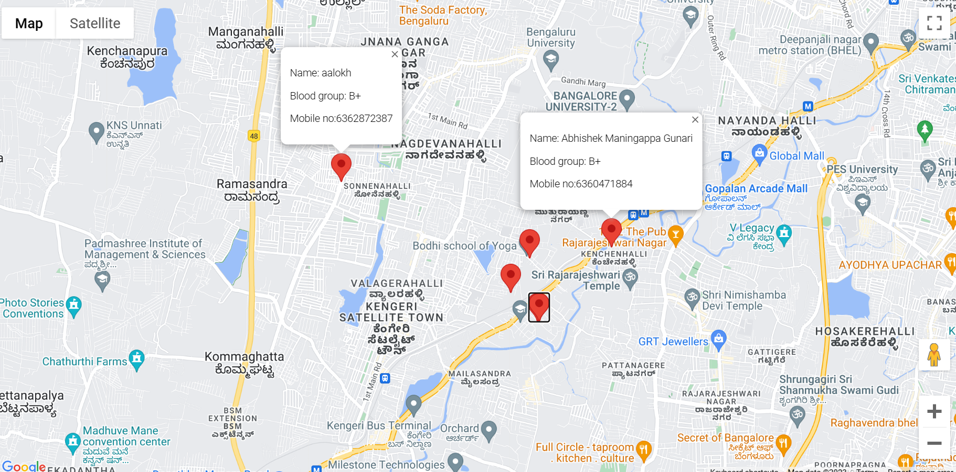
Go, change the world
RV College of
Engineering
Tasks performed during internship
*
Department of ECE
19

Slide 20
Go, change the world
RV College of
Engineering
Outcome of the Internship
HTML, CSS, and JavaScript Proficiency: Demonstrated the ability to responsive user interfaces using HTML for structure, CSS for styling, and JavaScript for dynamic and interactive elements.
Backend Development with PHP: Developed robust server-side logic and dynamic web pages using PHP, enhancing the functionality and interactivity of web applications.
Database Management with SQL: Applied SQL queries to design, create, and manage relational databases, ensuring efficient data storage, retrieval, and manipulation.
*
Department of ECE
20

Slide 21
Go, change the world
RV College of
Engineering
Google Maps API key : Successfully able to plot the location in maps using the geotags from the google maps API key.
Full-Stack Development: Acquired full-stack development skills by combining frontend (HTML, CSS, JavaScript) and backend (PHP, SQL) technologies, enabling end-to-end web application development.
*
Department of ECE
21

Slide 22
Go, change the world
RV College of
Engineering
Thank You
*
Department of ECE
22

